Slide 1
Sudoku Solver
Name - Abhishek Kumar Maurya
Registration No. – 12223228
Roll No. - 46
Section - 9SK02

Slide 2
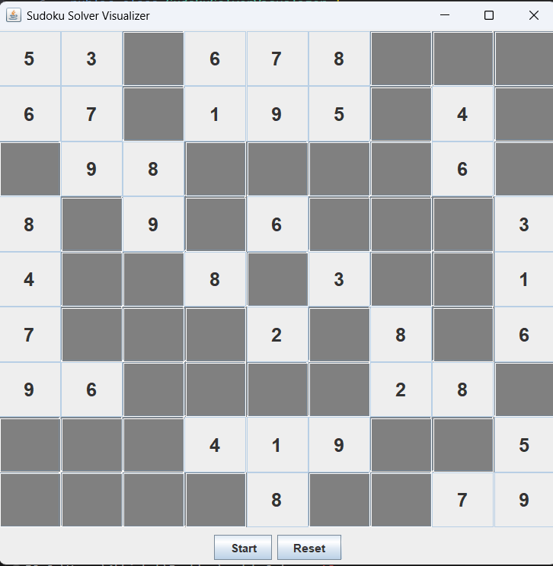
1. Introduction
The Sudoku Solver Visualization project is a Java-based application that provides a graphical interface for solving Sudoku puzzles. The project utilizes the backtracking algorithm to solve the puzzle and visualizes the solving process in real-time.

Slide 3
Features
Graphical Interface: The application features a graphical interface that displays the Sudoku board as a 9x9 grid of text fields.
Sudoku Solver: The application includes a Sudoku solver that uses the backtracking algorithm to solve the puzzle.
Visualization: The solving process is visualized in real-time, with each step of the algorithm highlighted on the board.
Reset Button: A reset button allows the user to reset the board to its initial state.
Start Button: A start button initiates the solving process.

Slide 4
Code Structure
SudokuSolverVisualizer: The main class that contains the GUI components and the solving logic.
solveSudoku: The method that implements the backtracking algorithm to solve the puzzle.
isValid: The method that checks if a number can be placed at a given position without violating Sudoku rules.
usedInRow, usedInCol, usedInBox: Methods that check if a number is already used in a row, column, or box.
resetBoard: The method that resets the board to its initial state.

Slide 5
Algorithm used
Backtracking algorithm is used to solve the Sudoku puzzle. The Backtracking algorithm is a recursive algorithm that tries to find a solution by incrementally building a solution and removing solutions that fail to satisfy the constraints.

Slide 6
Conclusion
The Sudoku Solver Visualization project is a Java-based application that provides a graphical interface for solving Sudoku puzzles. The application utilizes the backtracking algorithm to solve the puzzle and visualizes the solving process in real-time. The project demonstrates a clear understanding of the Sudoku solving algorithm and Java programming concepts.

